Slide 1
Appliances energy prediction
ALY6140 71238 Analytics Systems Technology
Northeastern University College of Professional Studies
Prof. Jialun He
Tongtong Wang, Jingxin Wang, Siyu Xiao

Slide 2

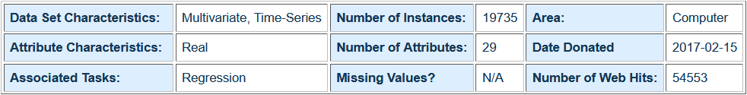
https://archive.ics.uci.edu/ml/datasets/Appliances+energy+prediction
Data Overview

Slide 3
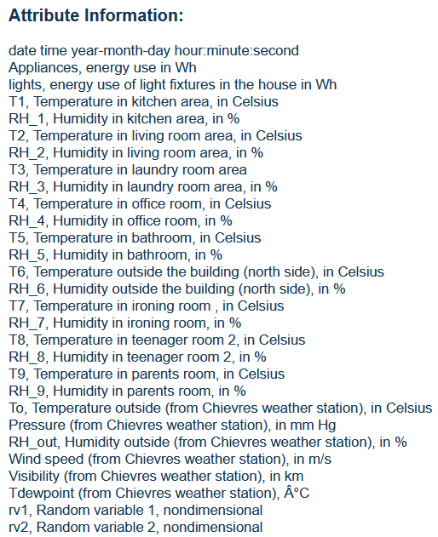
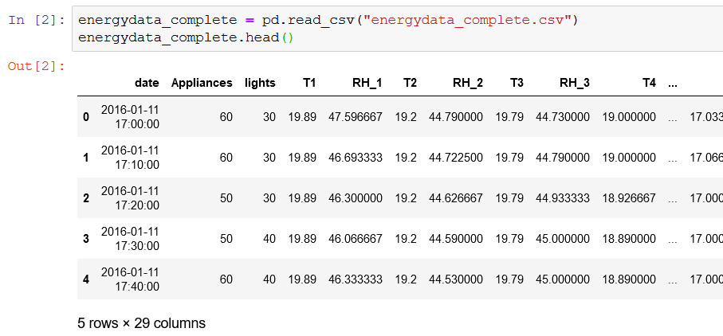
Data Overview

Slide 4
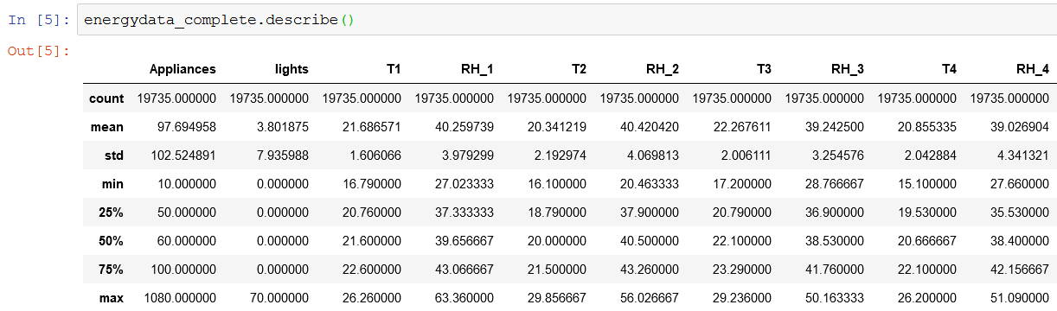
Data Overview

Slide 5
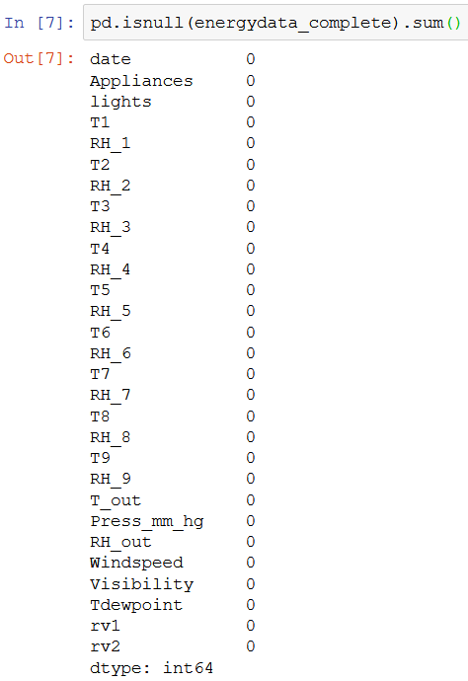
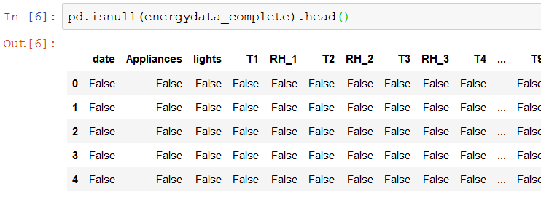
Data Overview

Slide 6
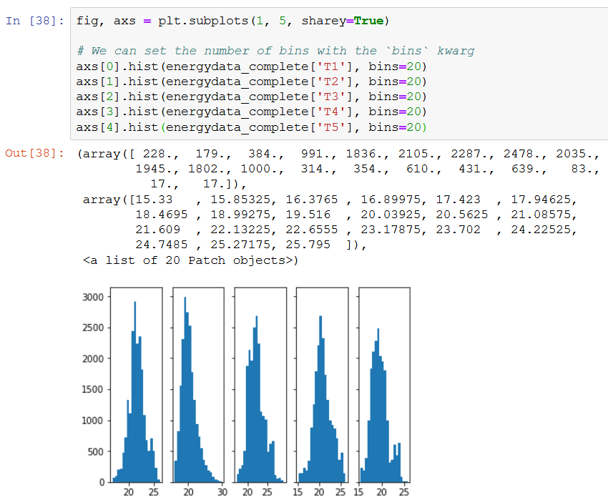
Data Visualization(Independent Variables)

Slide 7
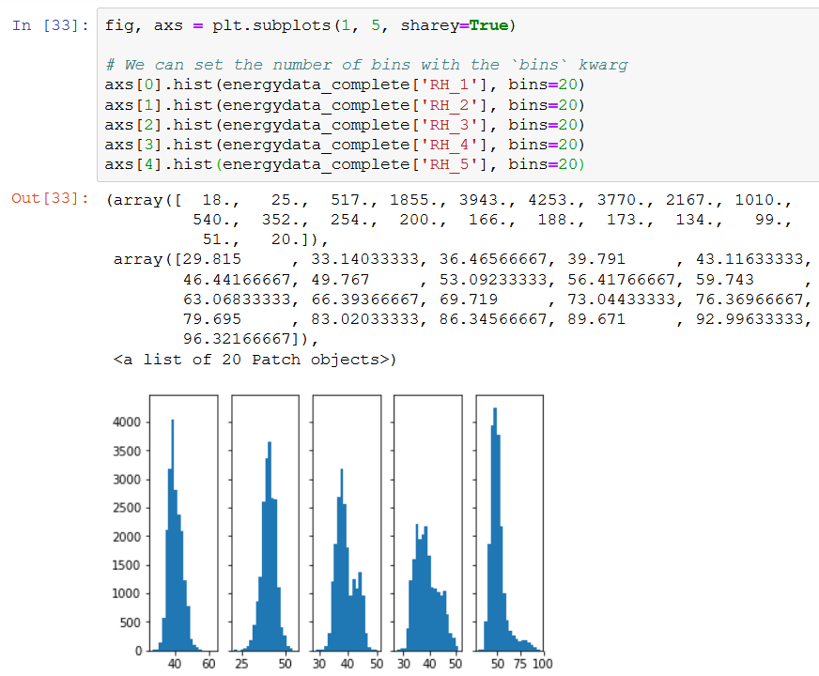
Data Visualization (Independent Variables)

Slide 8
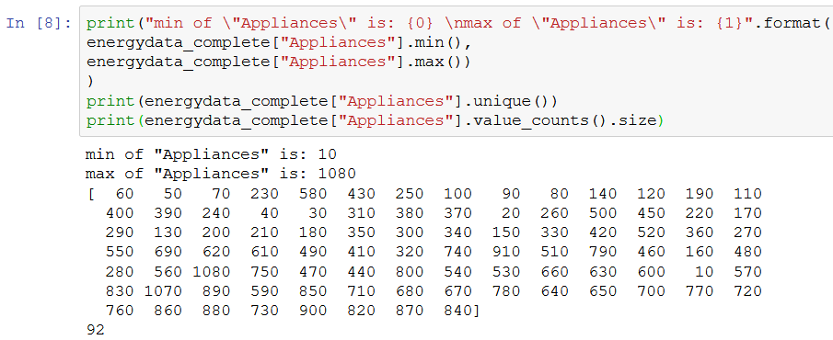
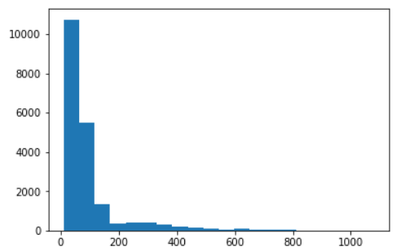
Data Visualization(“Appliances”)

Slide 9
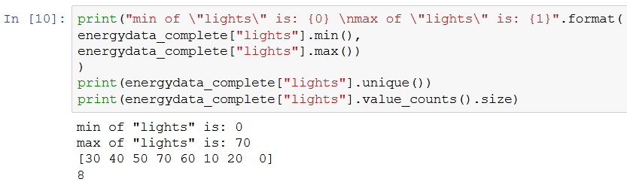
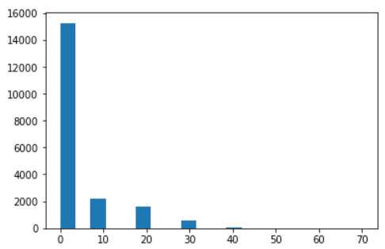
Data Visualization(“lights”)

Slide 10
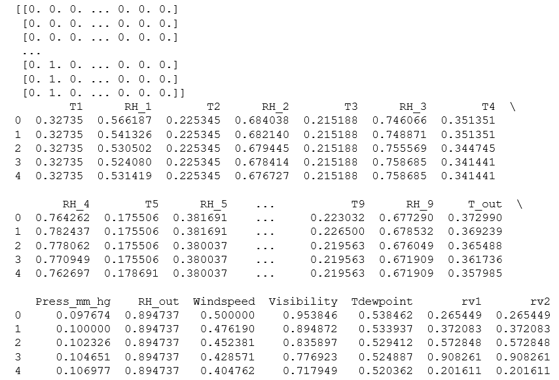
Data Preprocessing

Slide 11
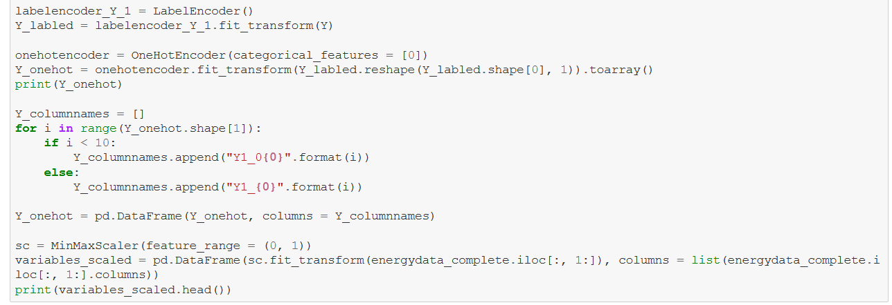
Data Preprocessing

Slide 12
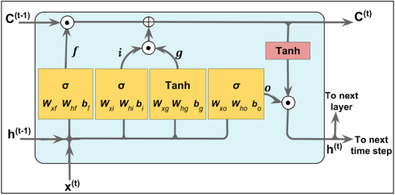
LSTM Cell
Model Selection

Slide 13
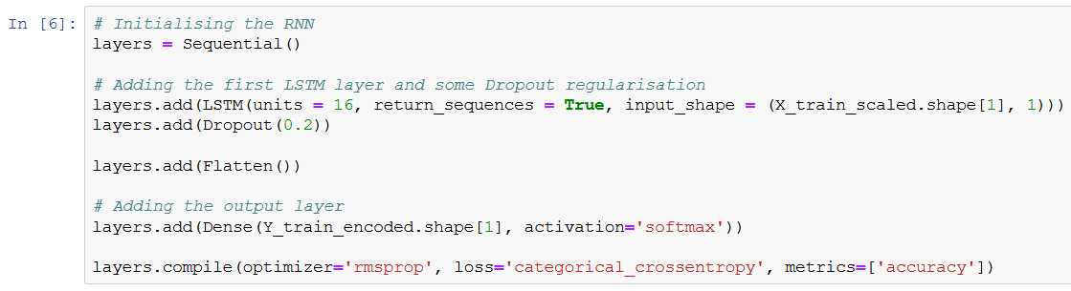
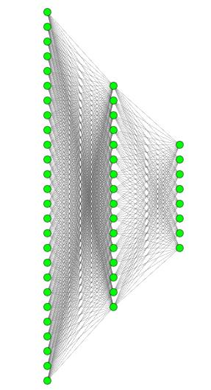
26
16
8
Model Selection(“lights”)

Slide 14
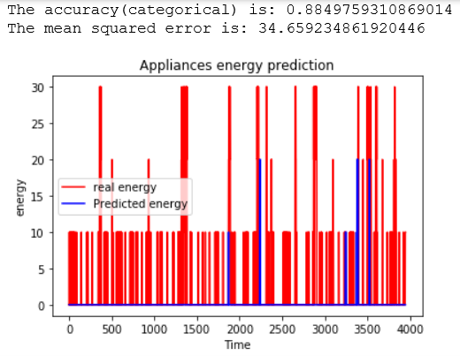
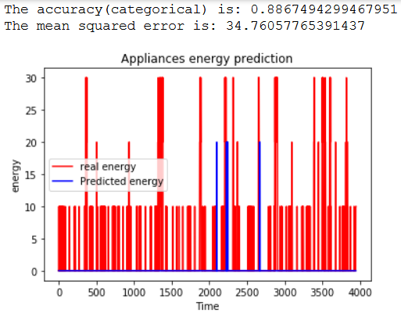
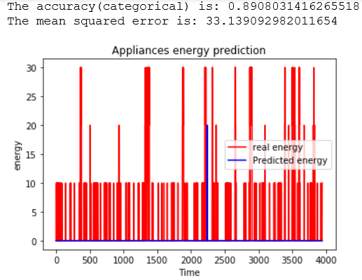
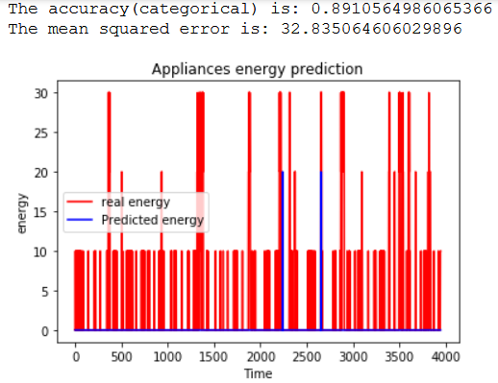
1
2
layers.fit(X_train_scaled,
Y_train_encoded,
epochs = 200,
batch_size = 2048)
3
4
Model Training(“lights”)

Slide 15
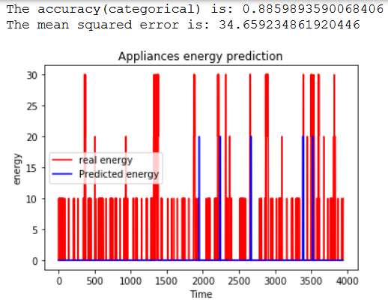
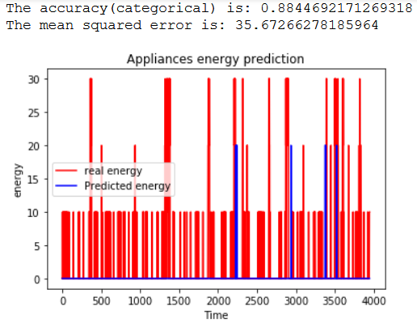
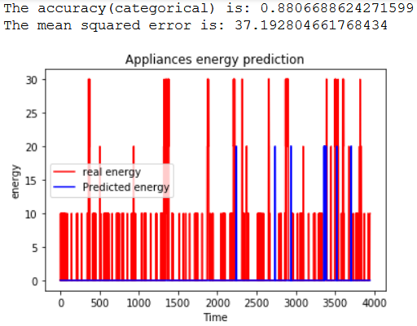
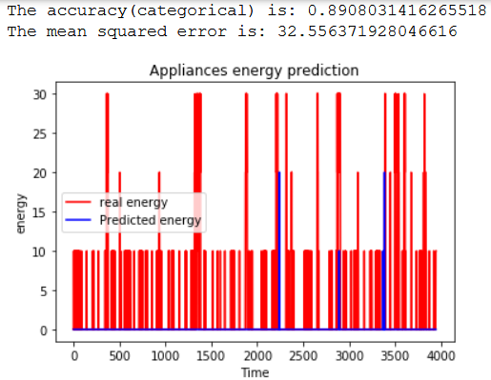
1
2
layers.fit(X_train_scaled,
Y_train_encoded,
epochs = 100,
batch_size = 512)
3
4
Model Training(“lights”)

Slide 16
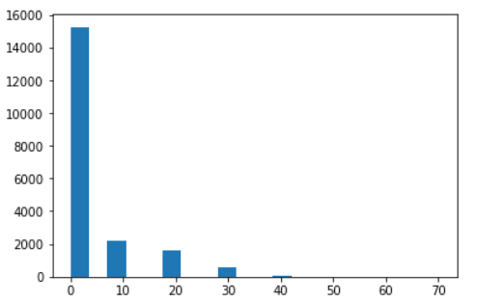
Biased
Model Diagnosis(“lights”)

Slide 17
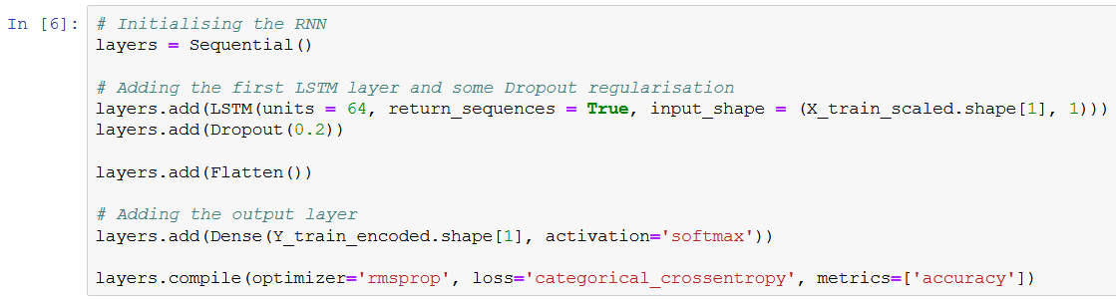
26
64
92
Model Selection(“Appliances”)

Slide 18
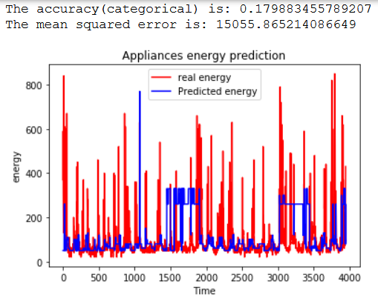
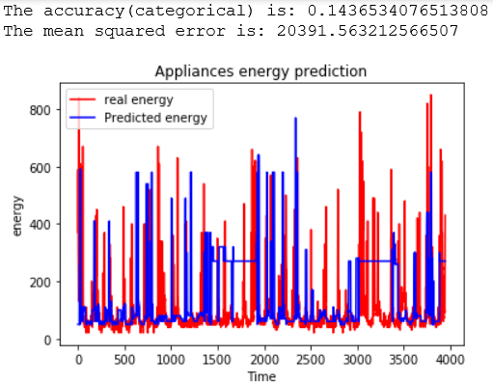
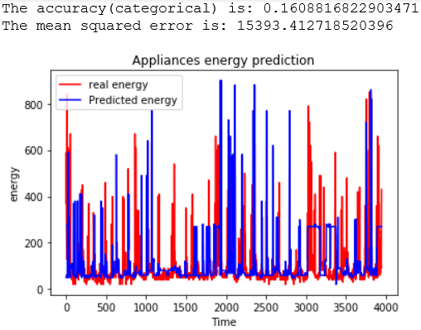
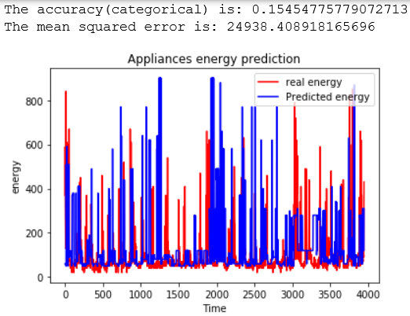
1
2
layers.fit(X_train_scaled,
Y_train_encoded,
epochs = 100,
batch_size = 512)
3
4
Model Training(“Appliances”)

Slide 19
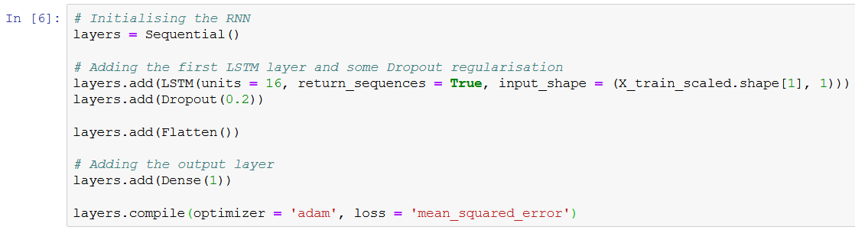
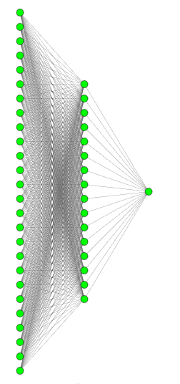
26
16
1
Model Selection(“Appliances”)

Slide 20
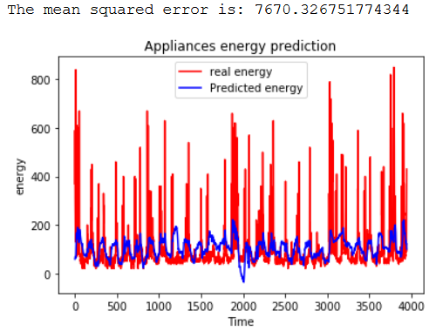
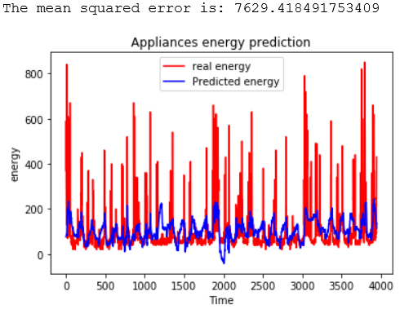
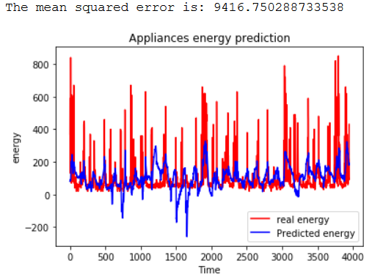
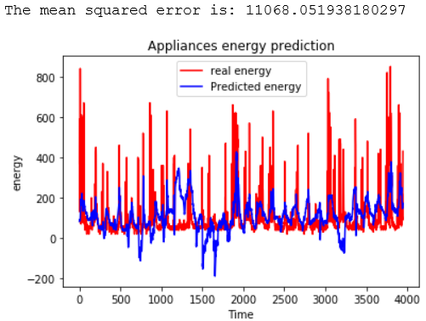
1
2
layers.fit(X_train_scaled,
Y_train_scaled,
epochs = 100,
batch_size = 512)
3
4
Model Training(“Appliances”)

Slide 21
Biased dataset
Model selections in one dataset
Limitation of simple graph demonstration
Chollet, F. (2018). Deep learning with Python. Shelter Island, NY: Manning Publications.
Raschka, S., & Mirajalili, V. (2017). Python machine learning: Machine learning and deep learning with Python, scikit-learn, and TensorFlow. Birmingham, UK: Packt Publishing.

